Slide 1

Cause - Effect Matrix and Analysis for Public Opportunities Relating to Space Missions
Amber Simon
Cassie Bowman
Arizona State University, School of Earth and Space Exploration

Slide 2

Project Overview
NASA’s Psyche mission, led by ASU, is a unique space mission targeting the metal-rich asteroid (16) Psyche. To inspire future generations and help everyone feel included in exploration, public engagement strategies are essential.

Slide 3
Goal
To find out which strategies are effective, this project tested and extended a weighted matrix (originally developed by Psyche capstone students) to evaluate public engagement strategies against a large set of criteria.
The goal is to provide a quantitative “score” for each item based on a qualitative assessment.

Slide 4
Methods

Slide 5
Methods
After coming up with a list of 22 additional public engagement strategies (bringing the total number of strategies analyzed to 45), they were evaluated using the criteria shown in Figure 1.
Each public engagement strategy received an independent quantitative score and qualitative justification.
Those individual scores, multiplied by the weights given to the criteria, resulted in a final score (out of a total of 558 possible points).

Slide 6
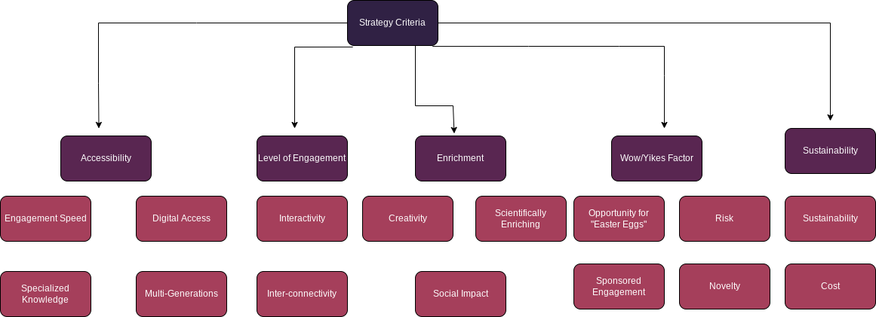
Figure 1: Flowchart

Slide 7
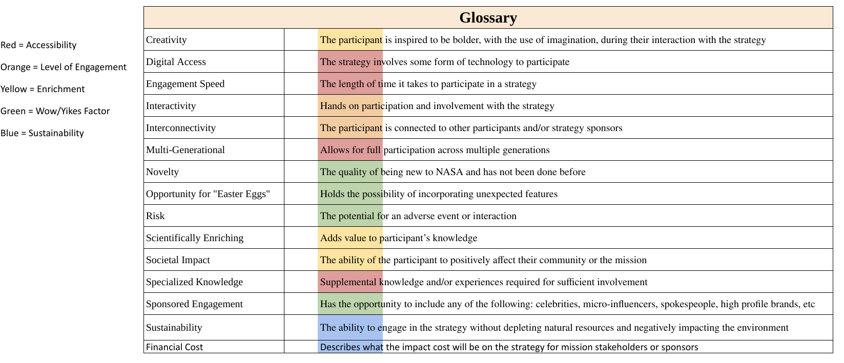

Slide 8
Example
Strategy: Streetwear/Clothing
Score: 195
Justification
Financial cost (for both consumer and producer) can be high.
Clothing is not as sustainable.
There is no scientifically enriching component.
These are a few reasons!
Clothing brands (ex. NASA sweatshirt) are very popular and nice souvenirs to have
This strategy scored fairly low/average.
Why?

Slide 9
Results

Slide 10
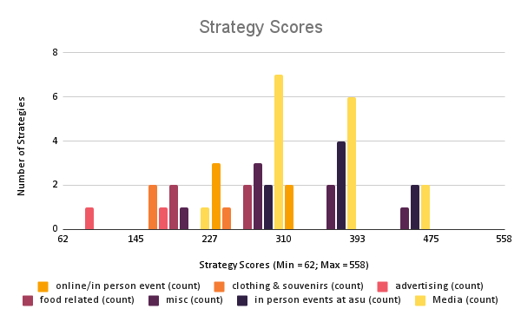
Preliminary Strategy Scores
Figure 2: A quantitative measurement of the scores for the strategies (grouped here by strategy type).
Scores of 1,3,5, and 9 were given in each weighted criteria category shown in Figure 1.

Slide 11
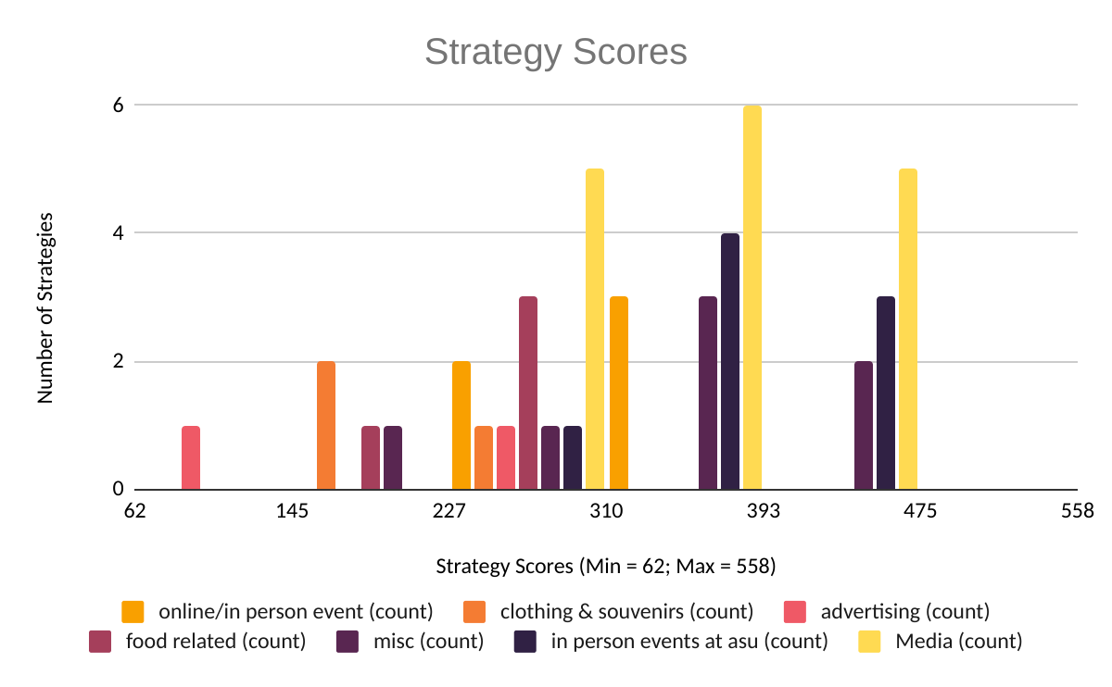
Final Strategy Scores
Figure 3: A quantitative measurement of the scores for the strategies (grouped here by strategy type) with a new factor, cost.

Slide 12
Conclusion

Slide 13
Implications and Future Use
Identifying areas to further improve the matrix (for example, adding new strategies and criteria)
Sharing these assessments of outreach strategies with other public engagement professionals
Sharing the matrix with other groups and missions

Slide 14
Acknowledgements
The original cause-effect matrix was created in partial fulfillment of Michigan State University Applied Engineering capstone courses. The work is a result of the Psyche Student Collaborations component of NASA’s Psyche Mission (https://psyche.asu.edu). “Psyche: A Journey to a Metal World” [Contract number NNM16AA09C] is part of the NASA Discovery Program mission to solar system targets. Trade names and trademarks of ASU and NASA are used in this work for identification only. Their usage does not constitute an official endorsement, either expressed or implied, by Arizona State University or National Aeronautics and Space Administration. The content is solely the responsibility of the authors and does not necessarily represent the official views of ASU or NASA. https://psyche.asu.edu/capstone-projects
Special thanks to Cassie Bowman and the Psyche Student Collab Team, AZ NASA Space Grant

Slide 15
Thank You

